Slide 1
Kirchhoff’s Laws
Kirchhoff’s Current Law (KCL):
  The algebraic sum of all the currents entering any node in a circuit equals zero. (An expression of the conservation of charge.)
Kirchhoff’s Voltage Law (KVL):
  The algebraic sum of all the voltages around any loop in a circuit equals zero. (As a result of conservation of energy.)
EE 42 and 100, Fall 2005
Week 1

Slide 2
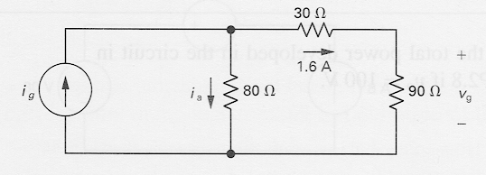
Example: Power Absorbed by a Resistor
p = vi = ( iR )i = i²R
p = vi = v ( v/R ) = v²/R
Note that p > 0 always, for a resistor.
  Example:
  Calculate the voltage v_{g} and current i_{a}.
  Determine the power dissipated in the 80Ω resistor.
EE 42 and 100, Fall 2005
Week 1

Slide 3
Construction of a Circuit Model
The electrical behavior of each physical component is of primary interest.
We need to account for undesired as well as desired electrical effects.
Simplifying assumptions should be made wherever reasonable.
EE 42 and 100, Fall 2005
Week 1

Slide 4
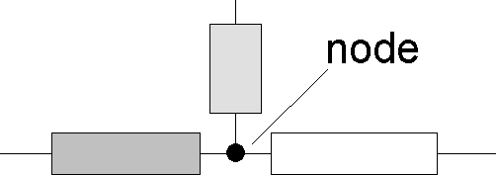
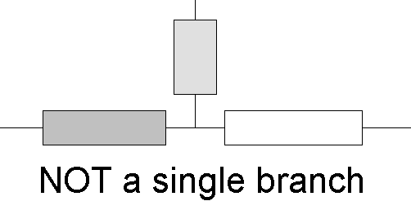
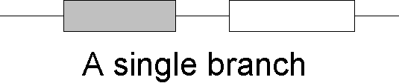
Terminology: Nodes and Branches
Node: A point where two or more circuit elements are connected
Branch: A path that connects two nodes
EE 42 and 100, Fall 2005
Week 1

Slide 5
Notation: Node and Branch Voltages
Use one node as the reference (the “common” or “ground” node) – label it with a symbol
The voltage drop from node x to the reference node is called the node voltage v_{x}.
The voltage across a circuit element is defined as the difference between the node voltages at its terminals
  Example:
– v₁ +
a
R₁
b
+
v_{a}
_
+
v_{b}
_
+
v_{s}
R₂
_
c
← REFERENCE NODE
EE 42 and 100, Fall 2005
Week 1

Slide 6
Using Kirchhoff’s Current Law (KCL)
Consider a node connecting several branches:
i₂
i₃
i₁
i₄
Use reference directions to determine whether currents are “entering” or “leaving” the node – with no concern about actual current directions
EE 42 and 100, Fall 2005
Week 1

Slide 7
Alternative Formulations of Kirchhoff’s Current Law
(Charge stored in node is zero.)
Formulation 1:
Sum of currents entering node
= sum of currents leaving node
Formulation 2:
Algebraic sum of currents entering node = 0
  Currents leaving are included with a minus sign.
Formulation 3:
Algebraic sum of currents leaving node = 0
  Currents entering are included with a minus sign.
EE 42 and 100, Fall 2005
Week 1

Slide 8
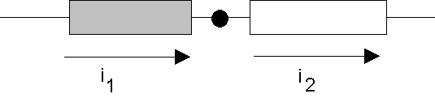
A Major Implication of KCL
KCL tells us that all of the elements in a single branch carry the same current.
We say these elements are connected in series.
Current entering node = Current leaving node
i₁ = i₂
EE 42 and 100, Fall 2005
Week 1

Slide 9
KCL Example
Currents entering the node:
Currents leaving the node:
-10 mA
i
5 mA
15 mA
3 formulations of KCL:
  1.
  2.
  3.
EE 42 and 100, Fall 2005
Week 1

Slide 10
Generalization of KCL
The sum of currents entering/leaving a closed surface is zero. Circuit branches can be inside this surface, i.e. the surface can enclose more than one node!
i₂
i₃
This could be a big chunk of a circuit, e.g., a “black box”
i₄
i₁
EE 42 and 100, Fall 2005
Week 1

Slide 11
Using Kirchhoff’s Voltage Law (KVL)
Consider a branch which forms part of a loop:
+
v₁
_
–
v₂
+
voltage
“drop”
voltage
“rise”
(negative drop)
loop
loop
Use reference polarities to determine whether a voltage is dropped – with no concern about actual voltage polarities
EE 42 and 100, Fall 2005
Week 1

Slide 12
Formulations of Kirchhoff’s Voltage Law
(Conservation of energy)
Formulation 1:
Sum of voltage drops around loop
= sum of voltage rises around loop
Formulation 2:
Algebraic sum of voltage drops around loop = 0
  Voltage rises are included with a minus sign.
Formulation 3:
Algebraic sum of voltage rises around loop = 0
  Voltage drops are included with a minus sign.
(Handy trick: Look at the first sign you encounter on each element when tracing the loop.)
EE 42 and 100, Fall 2005
Week 1

Slide 13
A Major Implication of KVL
KVL tells us that any set of elements that are connected at both ends carry the same voltage.
We say these elements are connected in parallel.
+
v_{a}
_
+
v_{b}
_
Applying KVL in the clockwise direction,
starting at the top:
v_{b} – v_{a} = 0 ➔ v_{b} = v_{a}
EE 42 and 100, Fall 2005
Week 1

Slide 14
Resistors in Series
Consider a circuit with multiple resistors connected in series.
Find their “equivalent resistance”.
KCL tells us that the same current (I) flows through every resistor
KVL tells us
I
R₁
R₂
V_{SS}
+
−
R₃
R₄
Equivalent resistance of resistors in series is the sum
of the individual resistances
EE 42 and 100, Fall 2005
Week 1

Slide 15
Voltage Divider
I = V_{SS} / (R₁ + R₂ + R₃ + R₄)
I
+
–
R₁
V₁
R₂
V_{SS}
+
+
–
−
R₃
V₃
R₄
EE 42 and 100, Fall 2005
Week 1

Slide 16
When can the Voltage Divider Formula be Used?
I
I
R₁
R₁
+
–
+
–
R₂
V₂
R₂
V₂
V_{SS}
+
V_{SS}
+
−
R₃
−
R₃
R₄
R₄
R₅
R
R
V
2
⋅
V
V
2
⋅
V
2
=
SS
2
≠
SS
R
+
R
+
R
+
R
R
+
R
+
R
+
R
1
2
3
4
1
2
3
4
Correct, if nothing else
is connected to nodes
because R₅ removes condition
of resistors in series
EE 42 and 100, Fall 2005
Week 1

Slide 17
Resistors in Parallel
Consider a circuit with two resistors connected in parallel.
Find their “equivalent resistance”.
x
KVL tells us that the
same voltage is dropped
across each resistor
  V_{x} = I₁ R₁ = I₂ R₂
KCL tells us
I₁
I₂
I_{SS}
R₁
R₂
EE 42 and 100, Fall 2005
Week 1

Slide 18
General Formula for Parallel Resistors
What single resistance R_{eq} is equivalent to three resistors in parallel?
I
I
+
+
V
R₁
R₂
R₃
eq
≡
V
R_{eq}
−
−
Equivalent conductance of resistors in parallel is the sum
EE 42 and 100, Fall 2005
Week 1

Slide 19
Current Divider
x
I₁
I₂
I_{SS}
R₁
R₂
V_{x} = I₁ R₁ = I_{SS} R_{eq}
EE 42 and 100, Fall 2005
Week 1

Slide 20
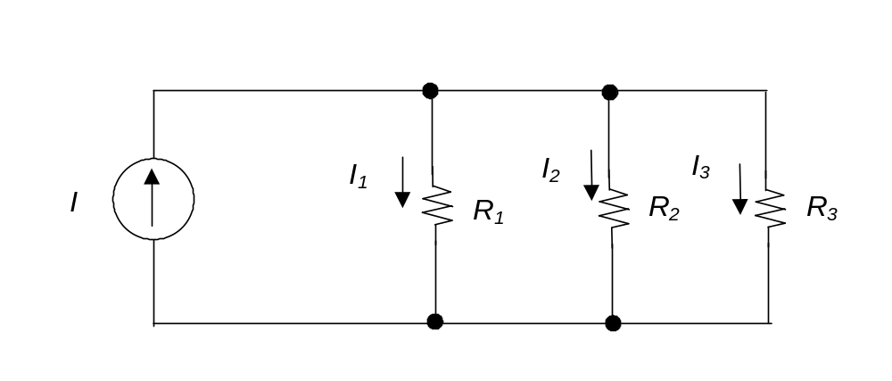
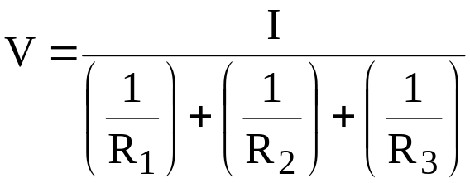
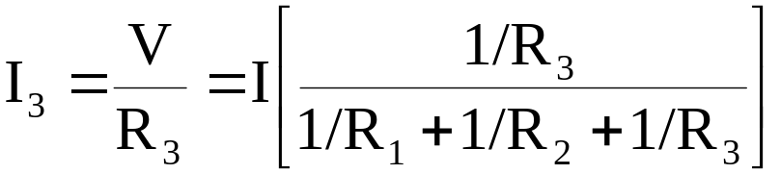
Generalized Current Divider Formula
Consider a current divider circuit with >2 resistors in parallel:
+
V
−
EE 42 and 100, Fall 2005
Week 1

